Slide 1
PROG6212 POE presented by Saadiq jattiem

Slide 2
Intro
Welcome to my presentation where I will be explaining and showing my final prog submission.
In the following powerpoint I will go over my design and functionality.

Slide 3
Project description
FOR THIS POE I USE WPF . NET FRAMEWORK TO OBTAIN APPLICATION DESIGN AND FUNCTIONALITY
For this POE we were asked to create a claim submission system for lecturers of an organization.
It works by lecturers submitting a claim and it being approved by coordinators. It would also have include HR who will have the last say over submitted claims
FOR THIS FINAL SUBMISSION WE ARE TASKED WITH ADDING IN AUTOMATION TO THE DIFFERENT USER VIEWS
AND FINALLY OUR PROGRAM MUST WORK IN RELATION TO A DATABASE

Slide 4
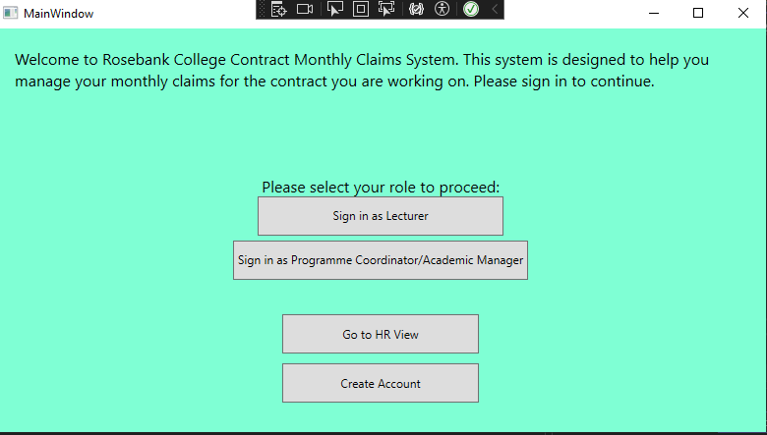
Home page

Slide 5
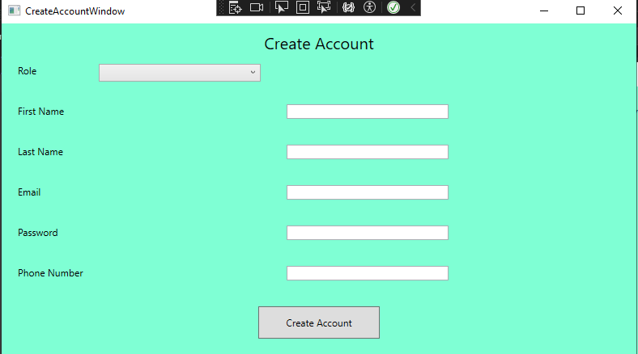
Account creation
In the picture you see you are required to create an account either for a programme coordinator or a lecturer

Slide 6
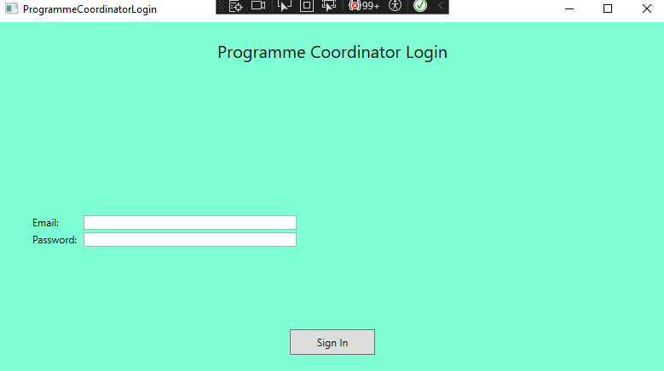
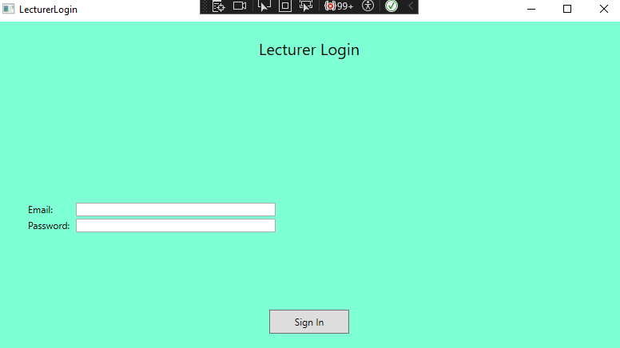
Sign in to the different accounts
In the pictures below you are prompted to sign into either the lecturer dashboard or the programme coordinator

Slide 7
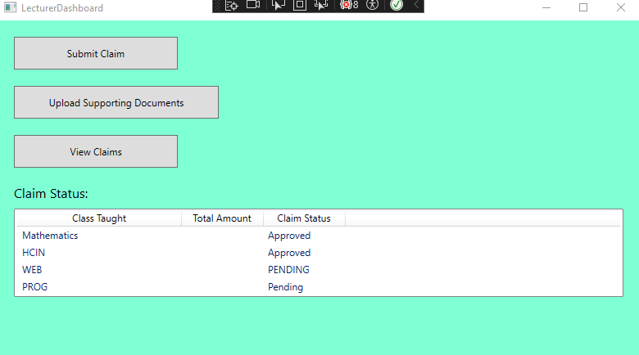
Lecturer dashboard
In the picture you will see the claims that is submitted with there statuses of each claim

Slide 8
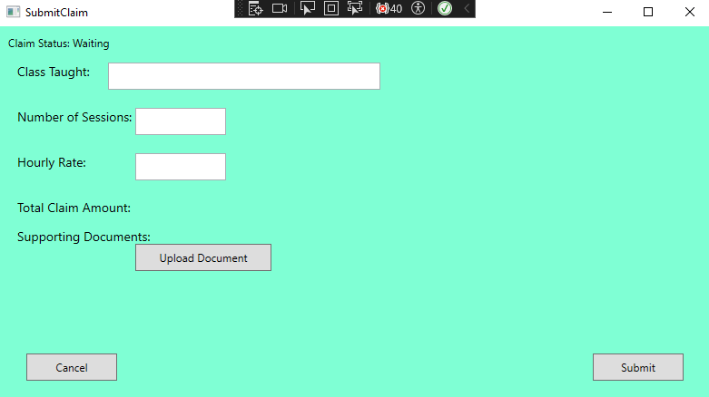
Submit claims
In this window you are asked to submit claims where you will fill out a form
And once filling out the form the calculations will run automatically because of the automation I have put into the code

Slide 9
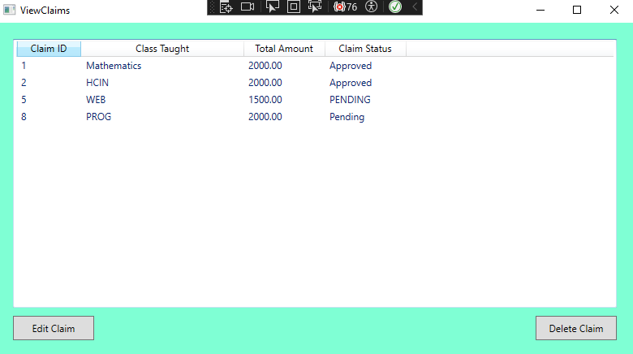
View claims
This allows you to see all the claims that was placed and also allows you to edit or delete a claim

Slide 10
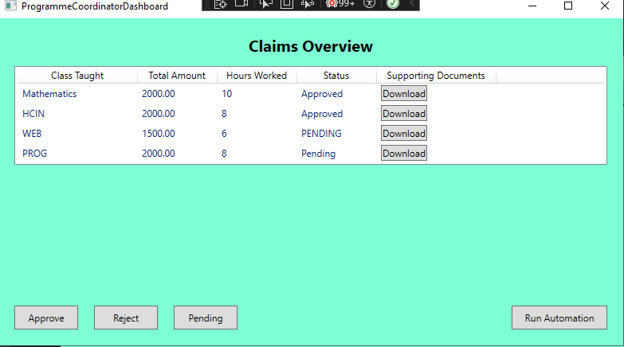
Programme coordinator dashboard
As you may see the claims will pop up from the lecturers and the programme coordinator can approve or reject or put it onto a pending status

Slide 11
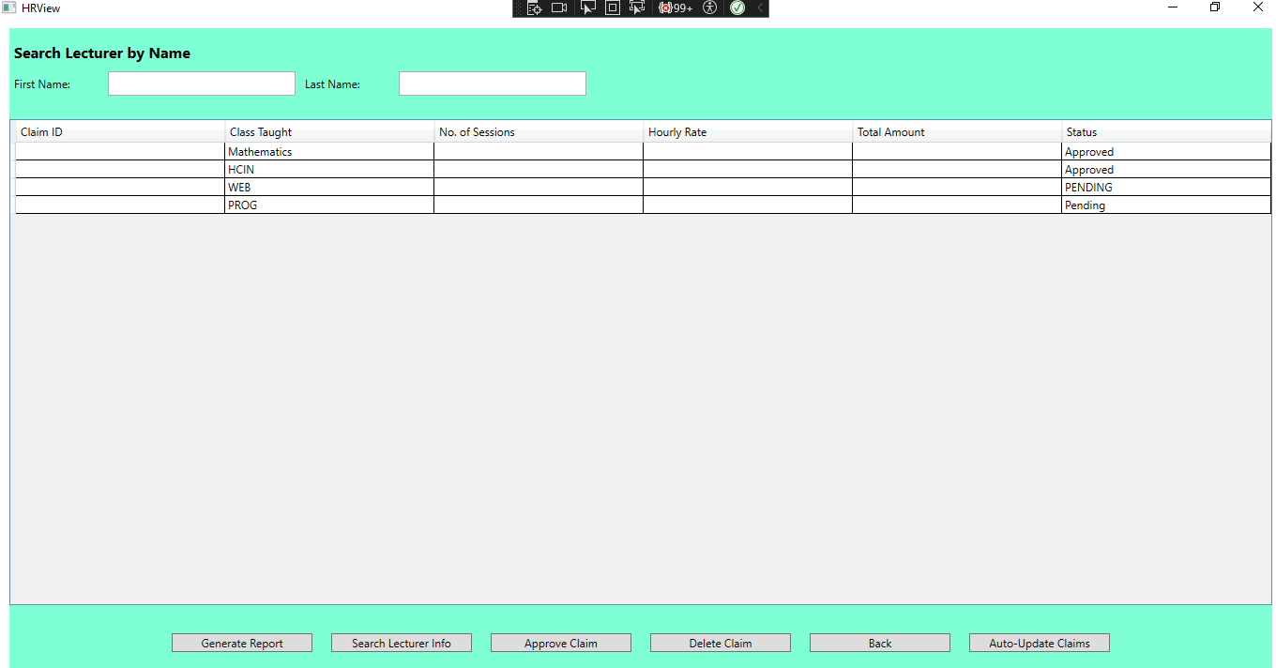
HR view
The HR view is a new feature which I created which allows the HR to generate a report, search for a lecturer, approve claims, delete claims, to go back to the homepage and also to auto update any claims that is needed

Slide 12
Final submission
THESE ARE ALL THE FEATURES I HAVE IMPLEMENTED INTO MY PROGRAM.
I HAVE ENSURED THAT ALL FEATURES ARE EASY TO UNDERSTAND AND THAT IT IS EASILY NAVIGATIONAL FOR ALL USERS. IT ALSO ALLOWS FOR USER ERROR HANDLING MESSAGES TO ENSURE THAT THEY DO NO EXECUTE A FUNCTION INCORRECTLY.

Slide 13
IN CONCLUSION MY PROGRAM HAS MEET THE REQUIREMENTS TO ENSURE THAT THE CLAIMS SYSTEM IS EASILY OPERATIONAL FOR USERS AND HAS AUTOMATION FOR THE FINAL SUBMISSION.
FOR A MORE DETAILED SCOPE OF THE OVERALL FUNCTIONS PLEASE CHECK SUBMITTED VIDEO.
Overview

Slide 14
Thank you
ST10303758
Moghammad Saadiq Jattiem

